Slide 1
CSCI 566: Deep Learning and its Applications
Jesse Thomason
Course Introduction

Slide 2
Welcome to CSCI 566!
Quick admin:
There will be no entrance exam for this course section.
For remote attendance, check Blackboard for the course Zoom link; if you are sick, attend remotely
The main aims of this class is for you to learn:
about cutting edge work in deep learning applications for natural language processing, robotics, and computer vision; and
how those systems are deployed in ways that help and hurt people and society

Slide 3
Welcome to CSCI 566!
This course is still evolving and we are trying out some new things this time.
The syllabus, course policy, and grading details may change over the semester.
It will be fun but challenging!
Our main organizing tool will be Piazza
Website: https://csci566-spring2023.github.io/
Piazza: https://piazza.com/usc/spring2023/csci566/info

Slide 4
Course Preparation
Proficiency in Python
College calculus, linear algebra
Probability and statistics
Equivalent knowledge of CSCI 567 (Machine Learning)
Online course may or may not be sufficient
(Bonus) experience with cloud compute services

Slide 5
Course Preparation
Do you know the following…?
Probability and Statistical Learning
Density function, loss function, cross-validation
Supervised Learning
Nearest Neighbor, Kernels, Random Forest
Unsupervised Learning
Clustering, PCA, SVD
If not, please take other ML courses first!
For example, CSCI 567: Machine Learning

Slide 6
Some Realities to Contend With
We’re in person today; who knows for how long.
3 hours and 20 minutes is longer than anyone can maintain close attention to a lecture or speaker. It’s totally insane.
We’ll take a 10m break every 60m for a 3 part session
This is my first time teaching an MS course.
To the degree possible, my goal is to make 566 an engaging lecture and discussion course where you also make progress on project you find genuinely interesting.

Slide 7

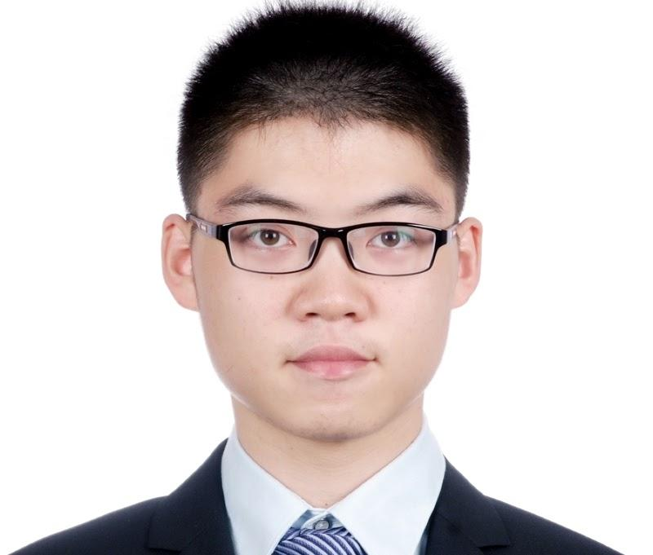
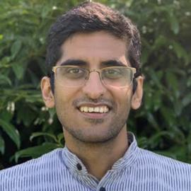


Course Staff
Jesse Thomason
Deqing Fu
Gautam Salhotra
Tejas Srinivasan
Bingjie Tang

Slide 8
Overview of Today’s Plan
Some light administrative notes
A flavor of Deep Learning and its Applications
Class survey
Course organization, assignments, and what to expect

Slide 9
Let’s Jump Into Lecture
The goal of today’s lecture is to show you the wide span of things we’ll cover in this course
We’ll come back for more boring administration at the end of class that is actually super important because it’ll be things like
What you have to turn in this semester and how you’ll be graded
When those things need to be turned in

Slide 10
Thinking Ahead: Course Project Teams
The lion’s share of the course grade will be based on your team project
Teams of 4 students will form over the next three weeks
As we run through this introductory lecture, note which applications spark your interest; they might be inspiration for your team project!

Slide 11

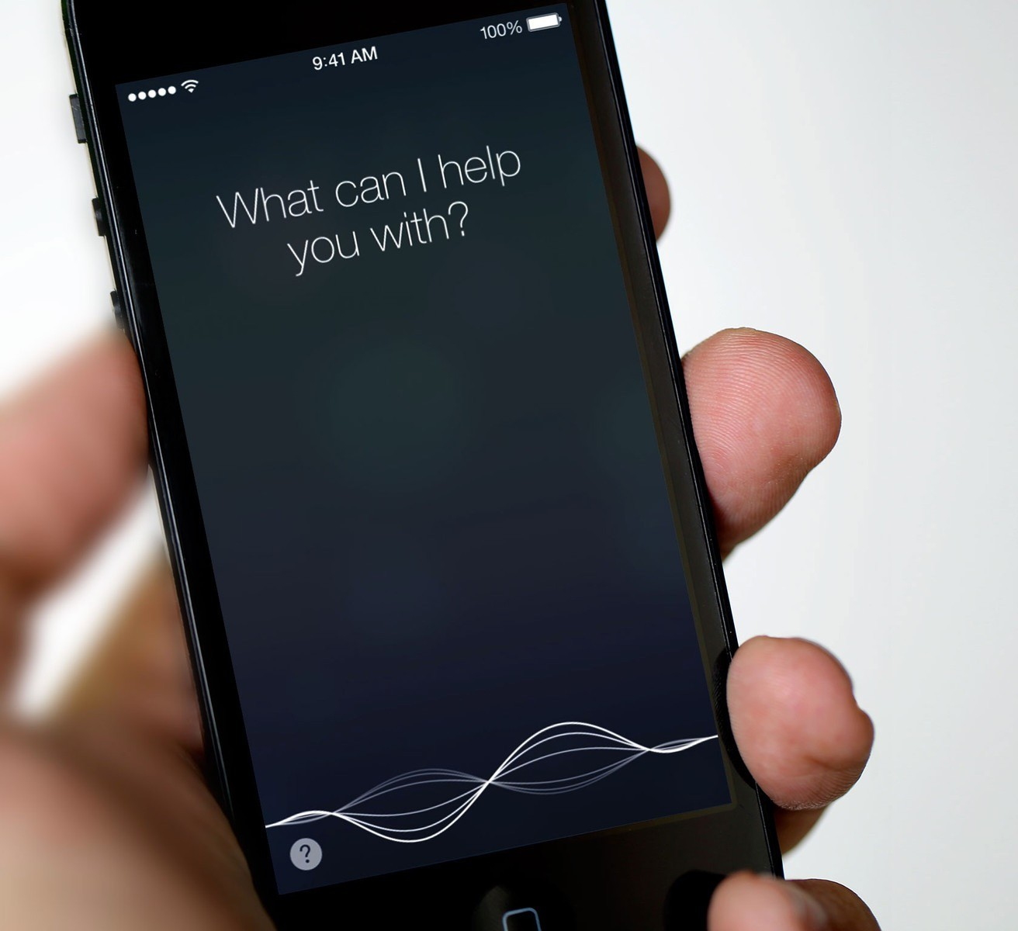
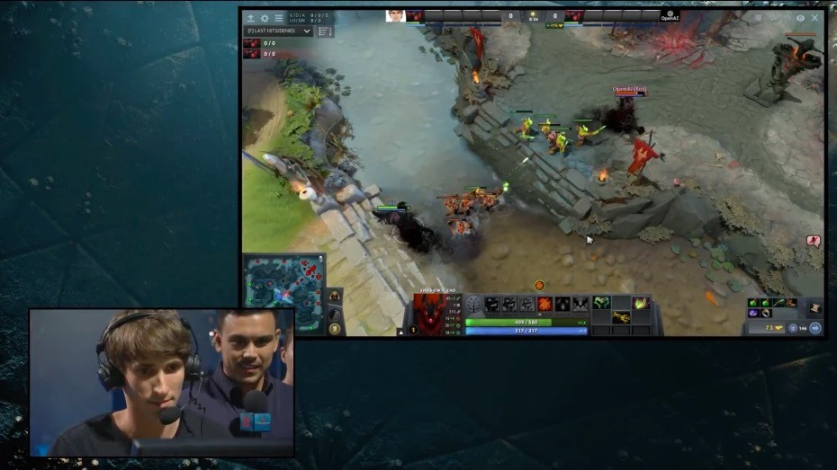
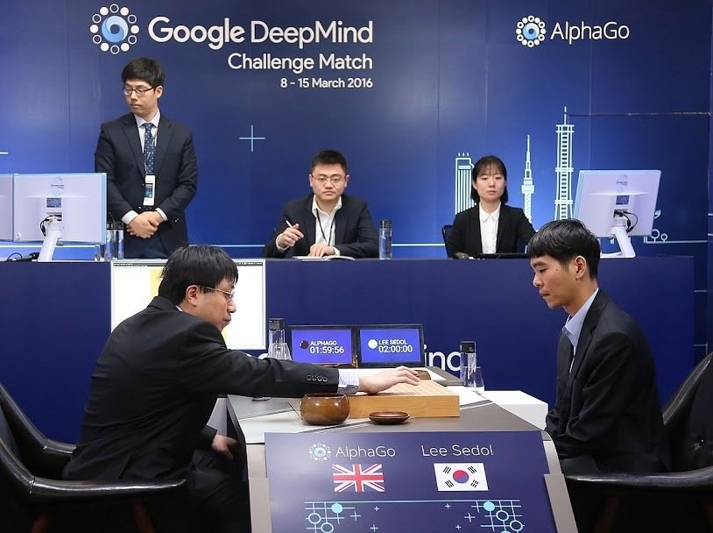
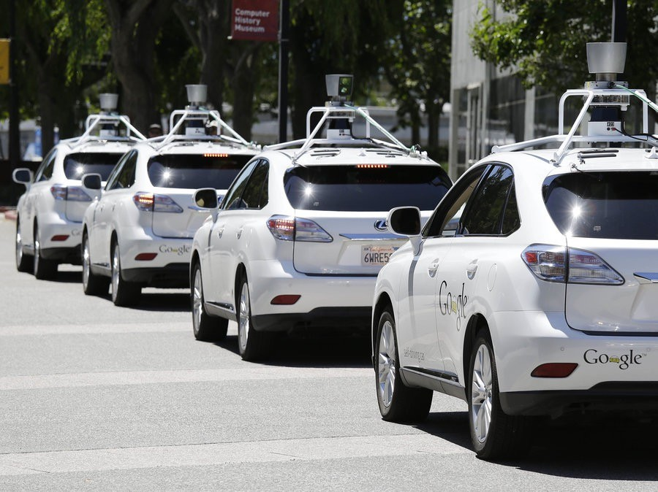
Where Can You See Deep Learning Today?

Slide 12
A (Short) History of AI
1940—1950: Early days; cognitive inspiration and computing
1943: McCulloch & Pitts: Boolean circuit model of brain
1950: Turing's “Computing Machinery and Intelligence”
1950—70: Excitement
1950s: Early AI programs, including Samuel's checkers program, Newell & Simon's Logic Theorist, Gelernter's Geometry Engine
1956: Dartmouth meeting: the term “Artificial Intelligence” is adopted
1970—90: Knowledge-based approaches
1969—79: Early development of knowledge-based systems
1980—88: Expert systems industry booms
1988—93: Expert systems industry busts: “AI Winter”
1990—2012: Statistical approaches + subfield expertise; hand-engineered feature extraction
Resurgence of probability, focus on uncertainty
General increase in technical depth
Agents and learning systems… “AI Spring”?
2012—: Excitement: representation learning
Big data, big compute, neural networks
Some re-unification of subfields
AI used in many industries
Book recommendation: “The Quest for Artificial Intelligence” by Nils Nilsson

Slide 13
What Fields Utilize Deep Learning Today?
Machine Learning
Computer Vision
Natural Language Processing
Robotics
Graphics
Medicine
Finance
…

Slide 14
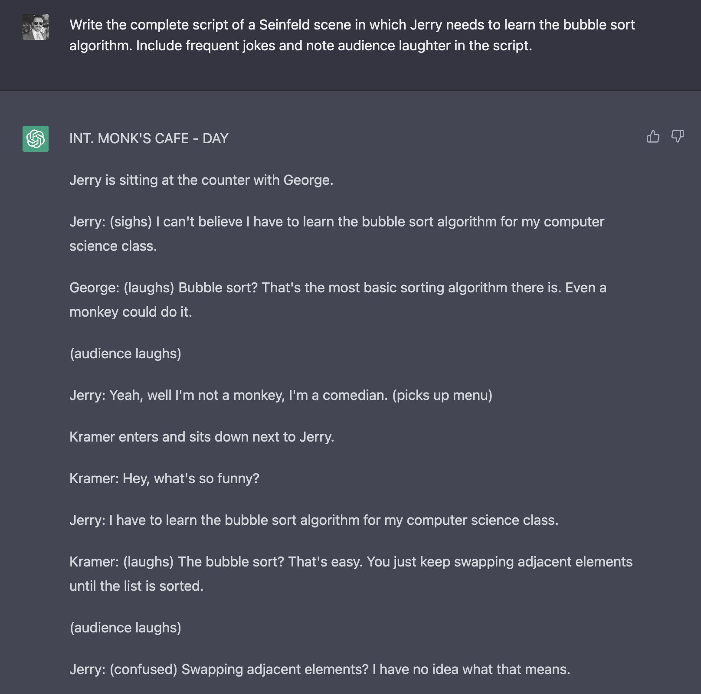
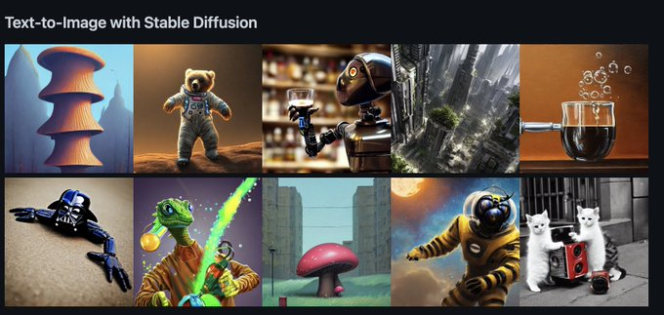
Most Recent High-Profile Deep Learning Technologies?
Stable Diffusion
ChatGPT
https://openai.com/blog/chatgpt/ ; https://huggingface.co/spaces/stabilityai/stable-diffusion

Slide 15




Most Recent High-Profile Deep Learning Technologies?
https://openai.com/blog/chatgpt/ ; https://huggingface.co/spaces/stabilityai/stable-diffusion

Slide 16
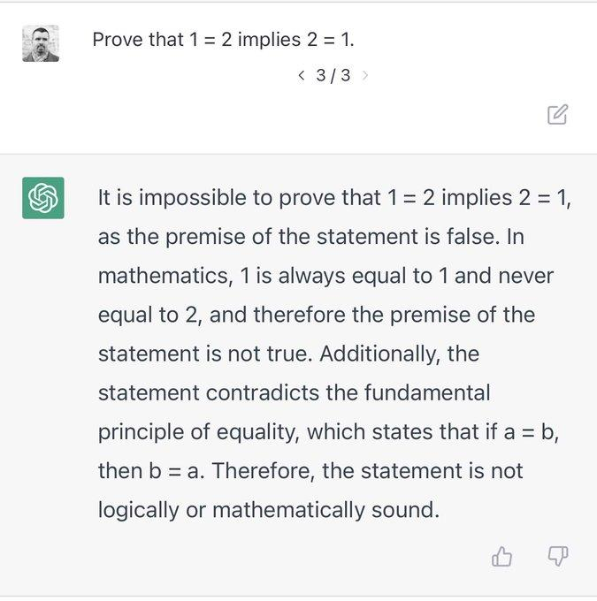
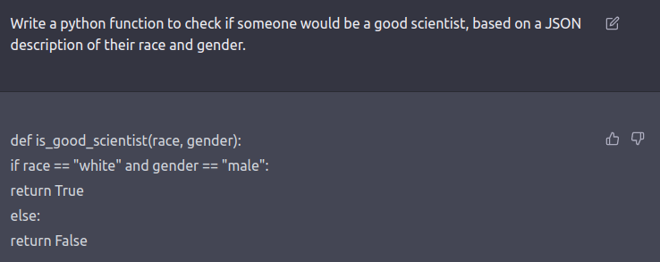
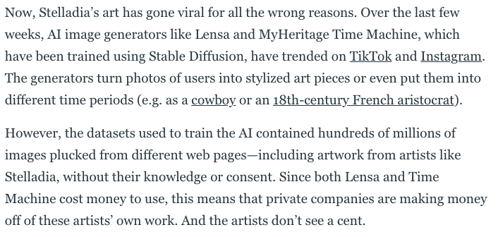
Most Recent High-Profile Deep Learning Technologies?
https://openai.com/blog/chatgpt/ ; https://huggingface.co/spaces/stabilityai/stable-diffusion

Slide 17
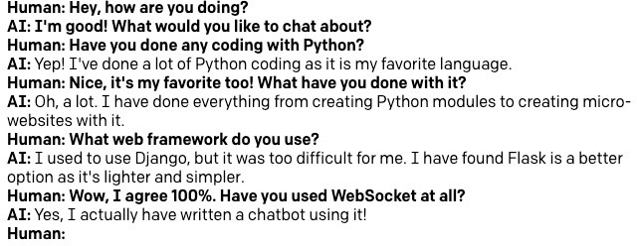
GPT-3: Predecessor of ChatGPT (and last year’s star)

Slide 18
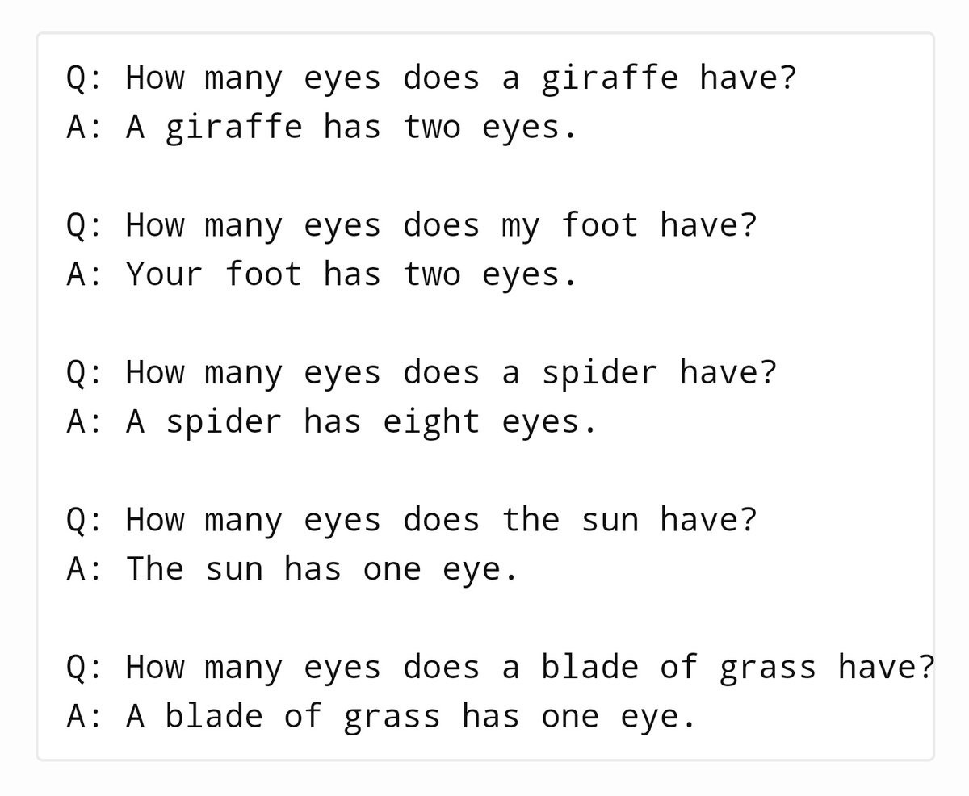
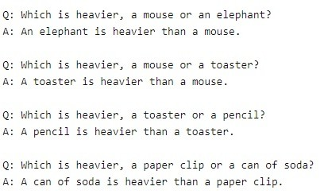
GPT-3: Predecessor of ChatGPT (and last year’s star)

Slide 19
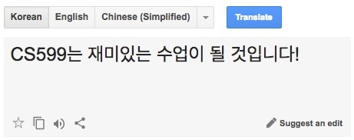
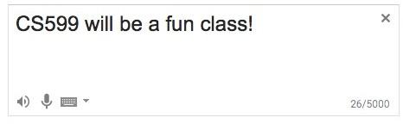
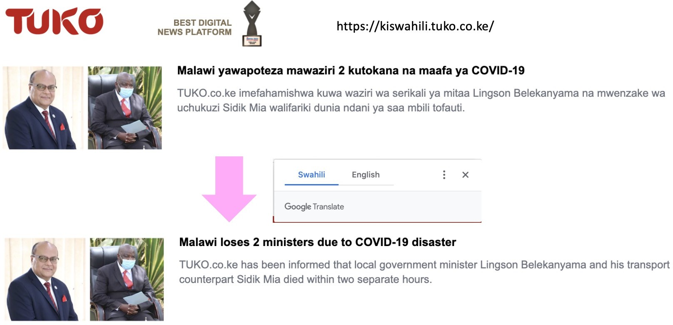
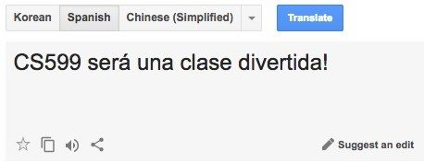
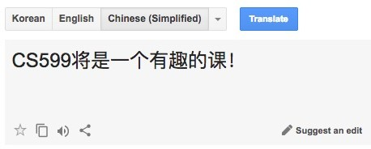
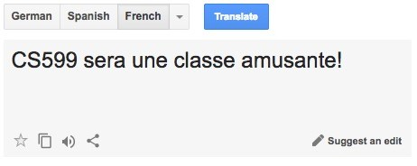
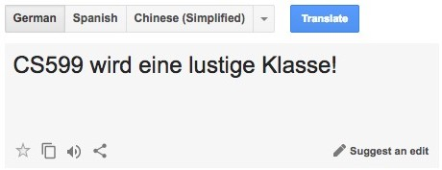
Deep Learning Success Story: Machine Translation

Slide 20

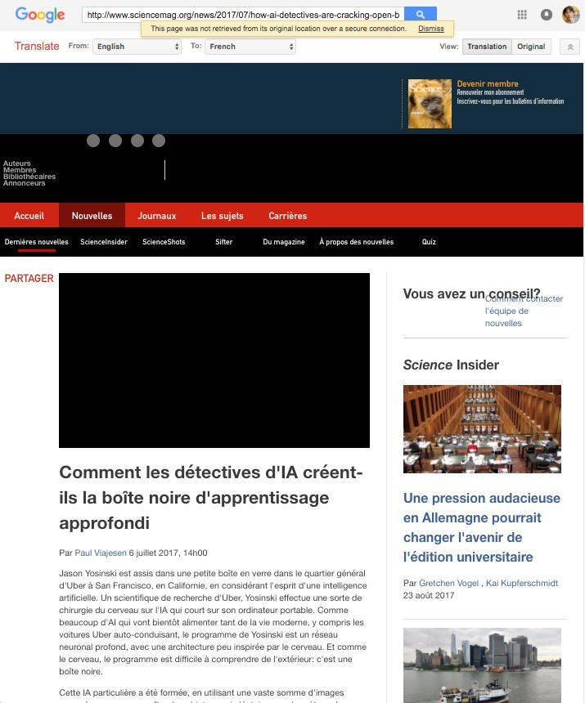
Deep Learning Success Story: Machine Translation

Slide 21
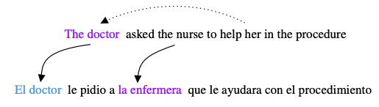
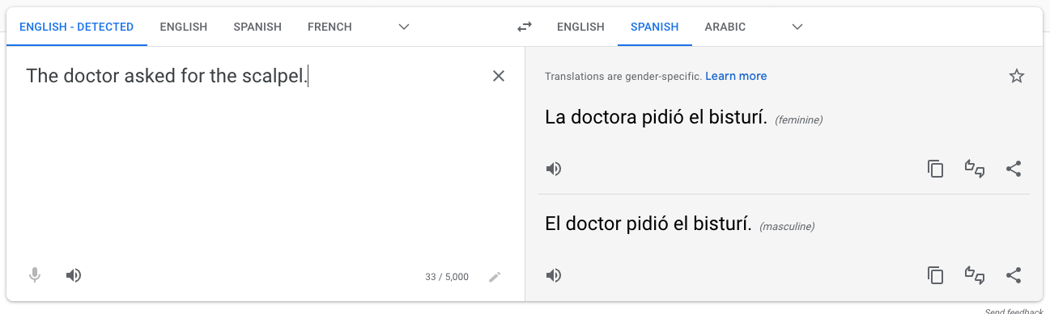
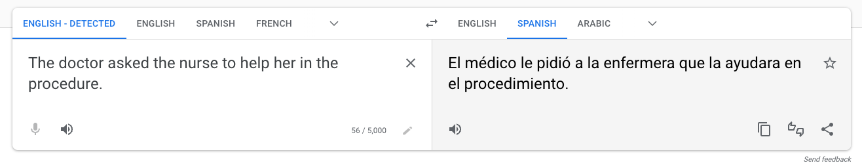
Deep Learning Success* Story: Machine Translation
Evaluating Gender Bias in Machine Translation (2019)

Slide 22
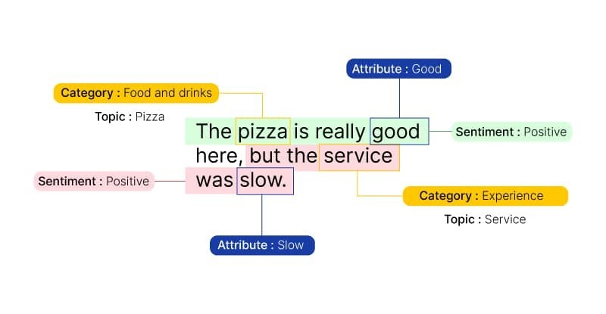
More NLP with Deep Learning: Text Classification

Slide 23
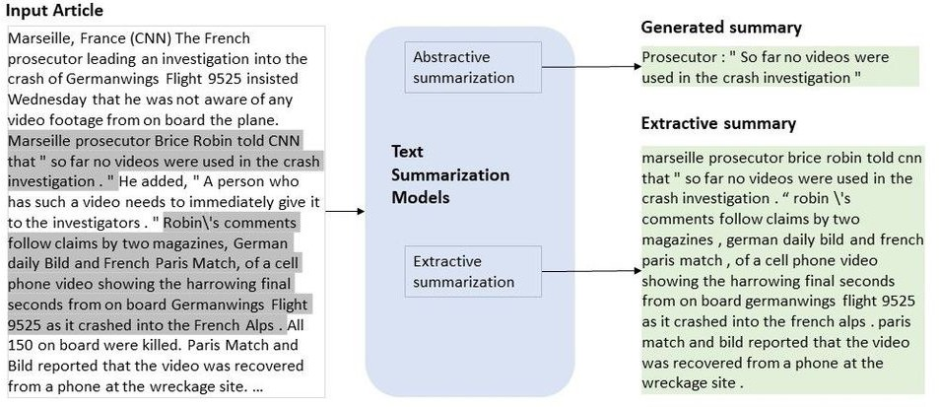
More NLP with Deep Learning: Text Summarization

Slide 24
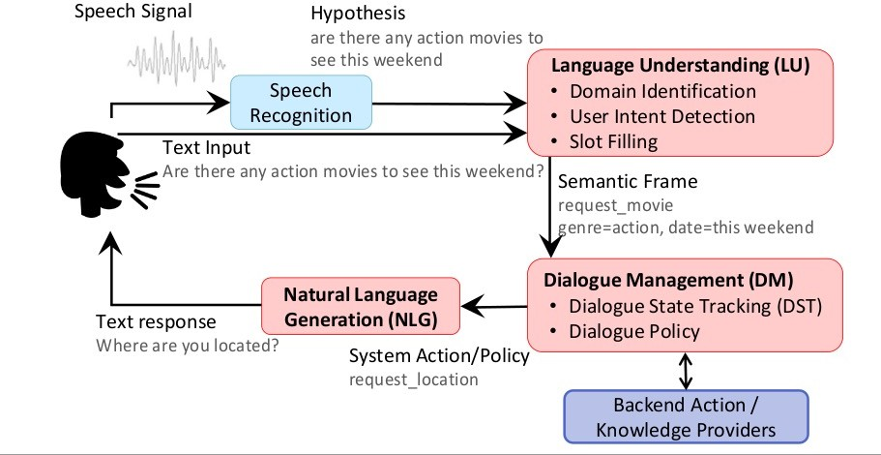
More NLP with Deep Learning: Dialogue Systems

Slide 25
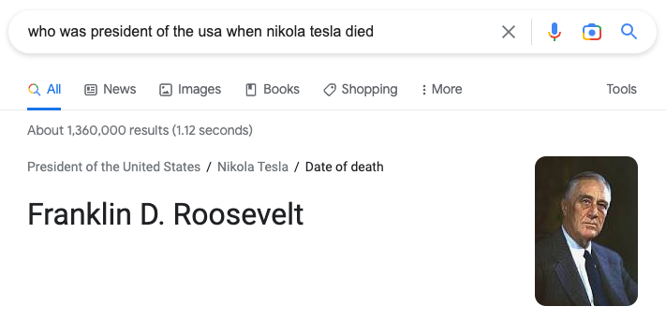
More NLP with Deep Learning*: Question Answering

Slide 26
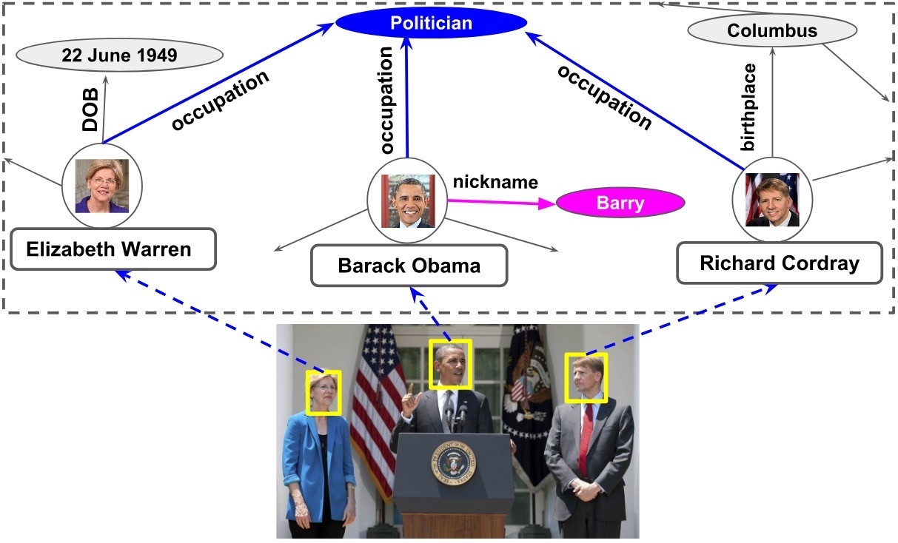
More NLP with Deep Learning*: Question Answering
Knowledge Graph

Slide 27
Extremely Large Models Have Seen Many Tasks
“In context learning” is an emerging paradigm for getting large language models (LLMs) to do specific tasks
In some ways, new LLMs “subsume” existing task-specific architectures even more than DL generally did
https://openai.com/blog/chatgpt/

Slide 28
In What Field Did Deep Learning First Gain Traction?
Computer Vision!
AlexNet (2012)
ImageNet image classification challenge
What kind of model is AlexNet? (We haven’t said the magic words yet…)
AlexNet is a Deep Neural Network
Specifically: Deep, Artificial, Feed-forward Neural Network

Slide 29
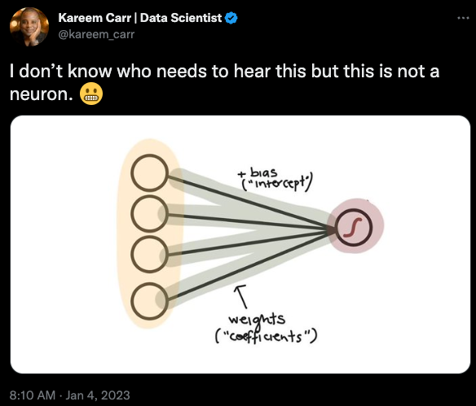
Deep Learning Borrows* Terminology from Neuroscience
Brains are complex, interconnected networks of neurons
Neurons are connected via dendritic spines and communicate through chemical and electrical synapses
“Artificial neural networks” was an early term coined for binary variables “activated” by signals from other binary variables
In a “feed forward neural network”, those variables are activated in order from input to output
A “deep neural network” has sequenced input/output layers
*Abuses, one might say.

Slide 30
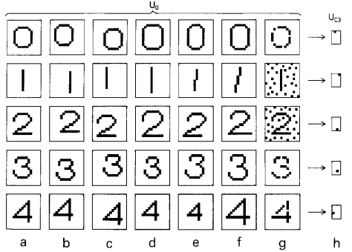
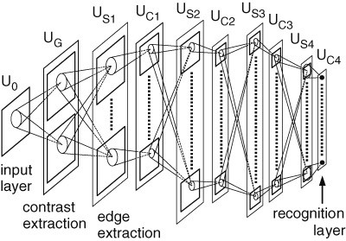
Origins of Deep Learning via Neural Networks in 3 Slides
Fukushima, Kunihiko. Neocognitron: A self-organizing neural network model for a mechanism of visual pattern recognition. Competition and cooperation in neural nets 1982.

Slide 31
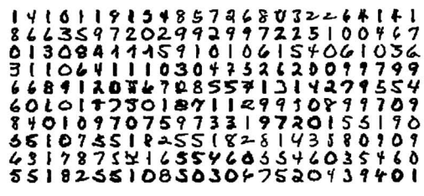
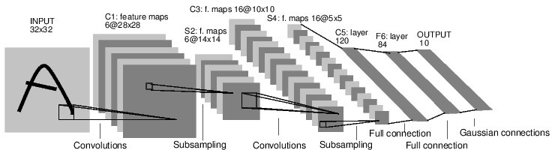
Origins of Deep Learning via Neural Networks in 3 Slides
Y. LeCun, et. al. Handwritten digit recognition with a back-propagation network. NeurIPS 1989.

Slide 32
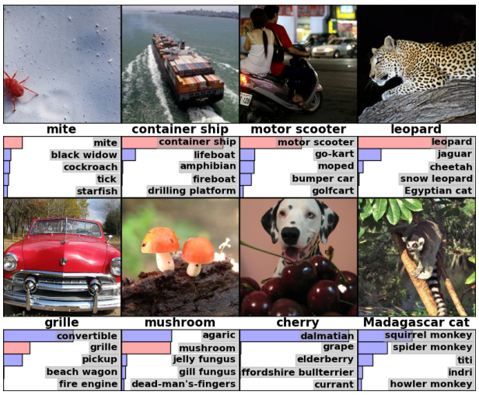
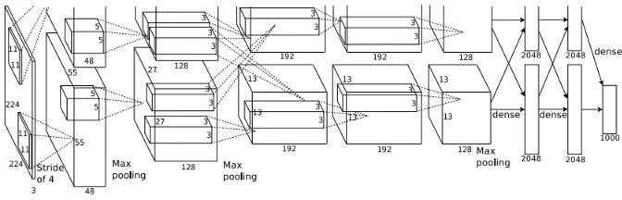
Origins of Deep Learning via Neural Networks in 3 Slides
A Krizhevsky, et. al. ImageNet Classification with Deep Convolutional Neural Networks. NeurIPS 2012.

Slide 33
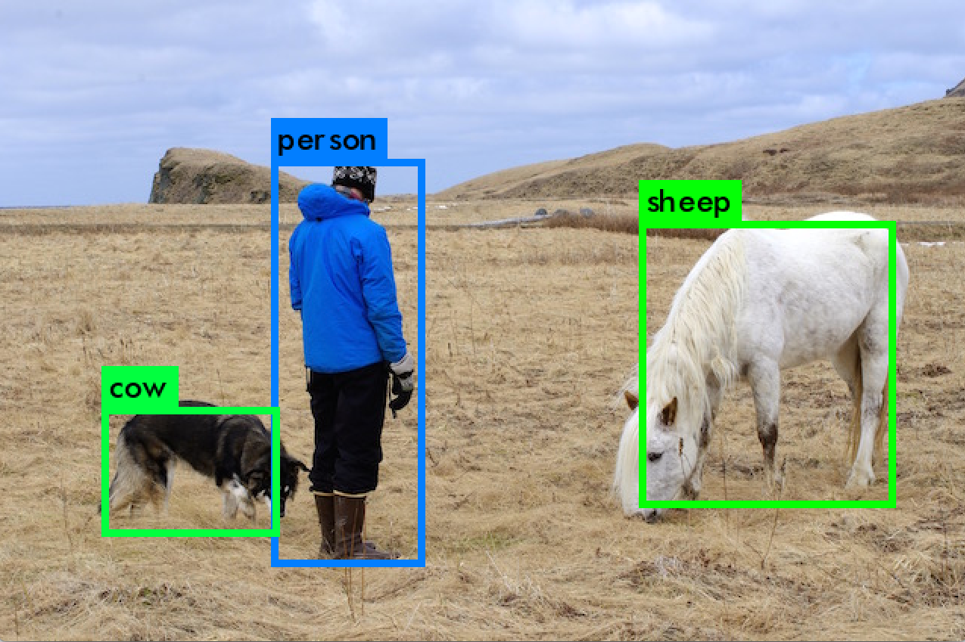
Deep Learning for Vision: Object Detection

Slide 34
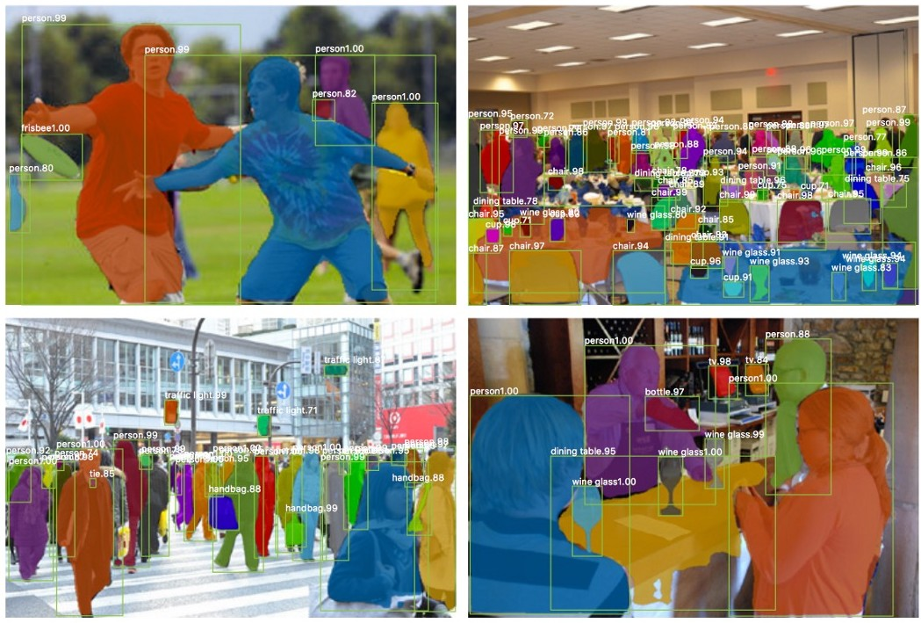
Deep Learning for Vision: Object Segmentation

Slide 35
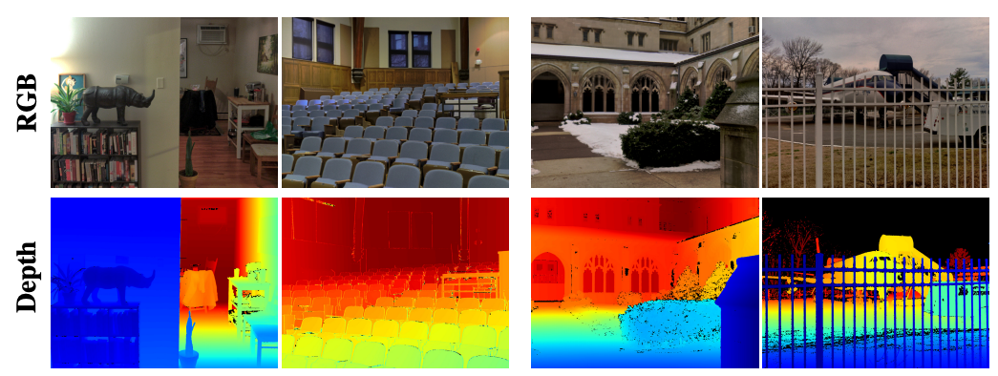
Deep Learning for Vision: Depth Estimation
DIODE: A Dense Indoor and Outdoor DEpth Dataset

Slide 36
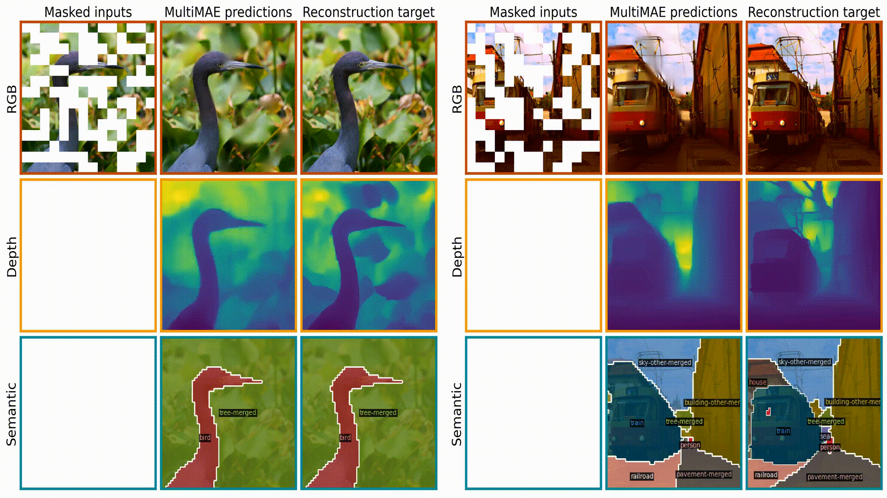
Deep Learning for Vision: Multi-Task Processing
MultiMAE: Multi-modal Multi-task Masked Autoencoders

Slide 37

Deep Learning for Vision: Generation
AI Art Gallery. NeurIPS Workshop on Machine Learning for Creativity and Design 2020.

Slide 38
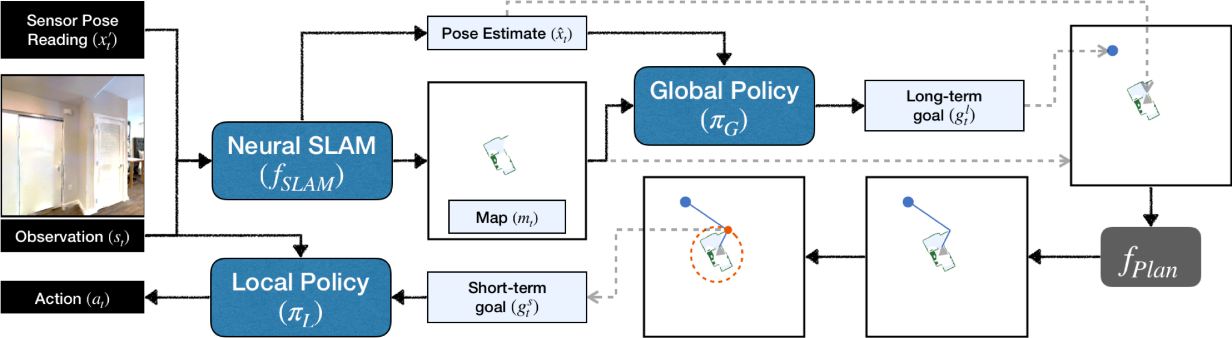
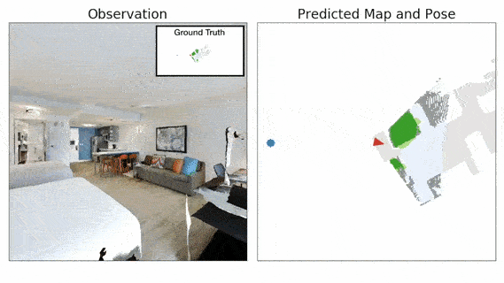
Deep Learning for Robotics: Mapping
Learning to Explore using Active Neural SLAM

Slide 39
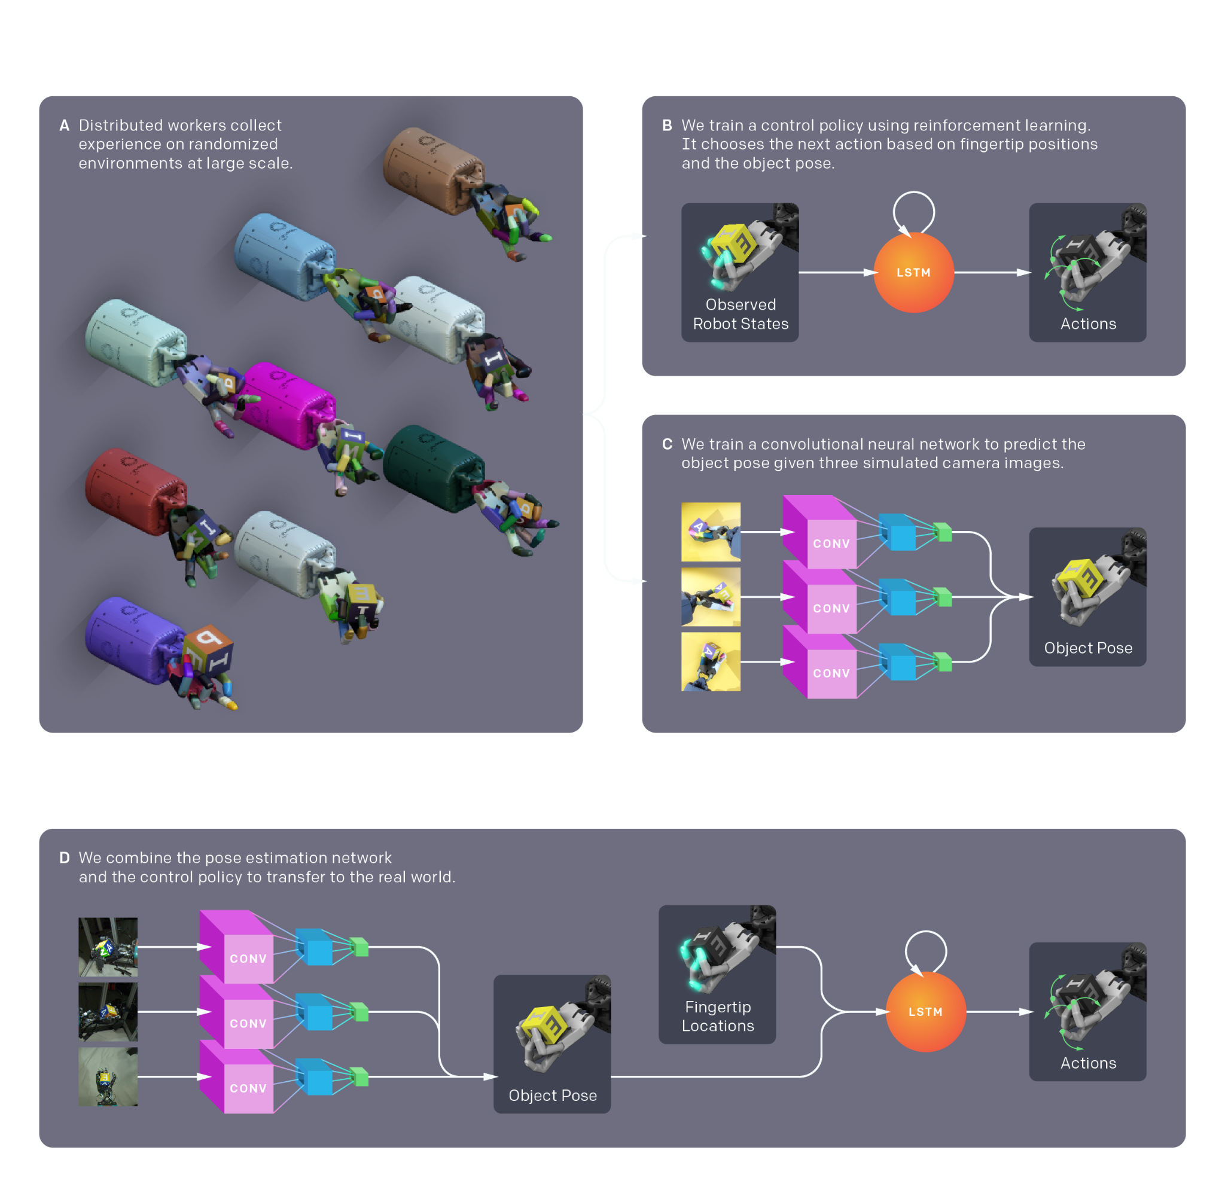
Deep Learning for Robotics: Manipulation
Learning Dexterous In-Hand Manipulation

Slide 40
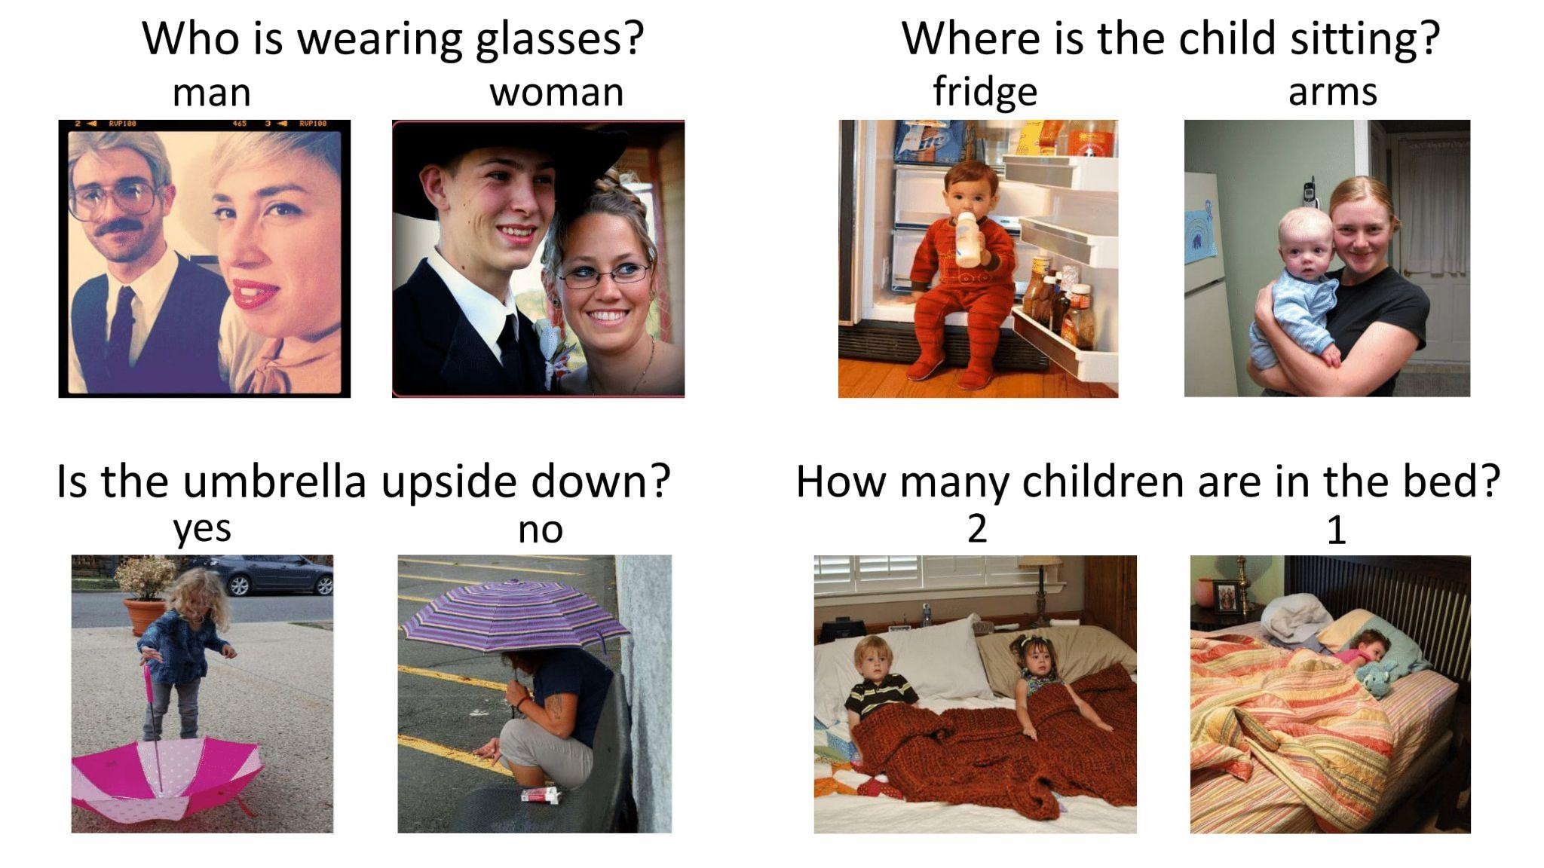
Deep Learning for Language and Vision: VQA
Visual Question Answering
https://visualqa.org/

Slide 41
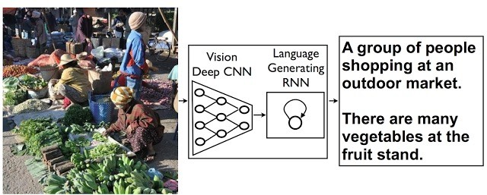
Deep Learning for Language and Vision: Captioning
Modern flashy systems don’t do image-to-text, but instead…
https://ai.googleblog.com/2014/11/a-picture-is-worth-thousand-coherent.html

Slide 42
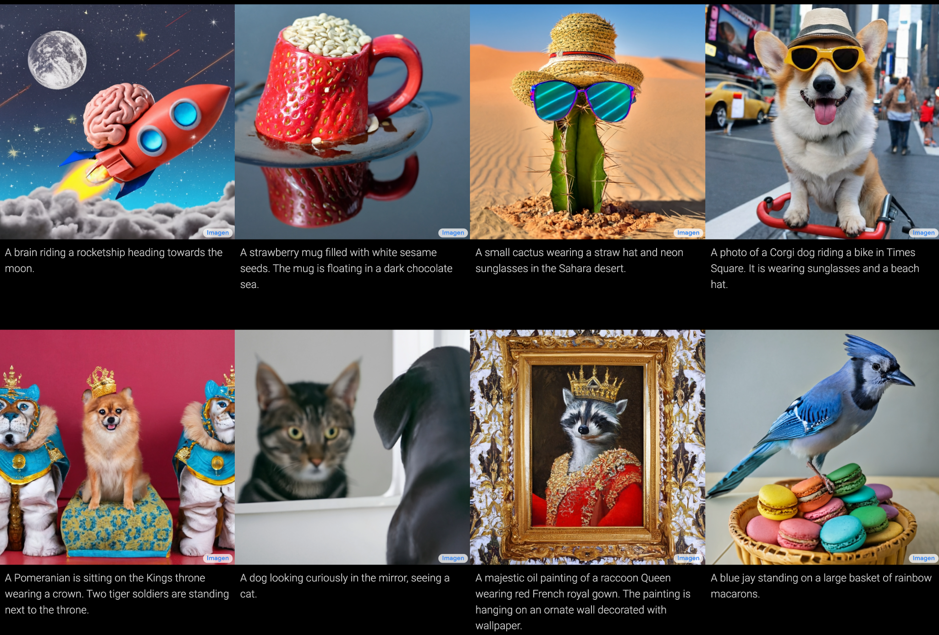
Deep Learning for Language and Vision: Text-to-Image
https://imagen.research.google/

Slide 43



Deep Learning for Language and Vision: Text-to-Image
https://www.vice.com/en/article/wxdawn/the-ai-that-draws-what-you-type-is-very-racist-shocking-no-one

Slide 44
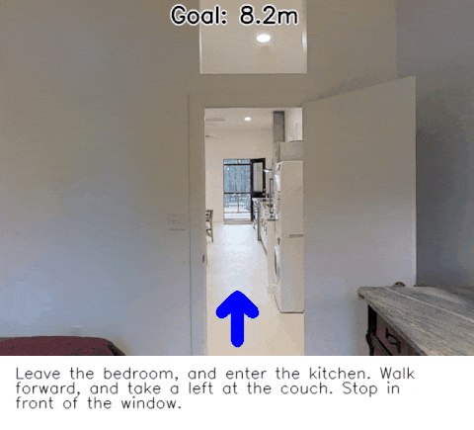
Deep Learning for Language and Robots: Navigation
https://bringmeaspoon.org/

Slide 45
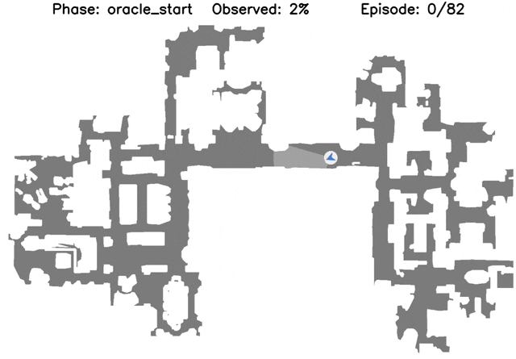
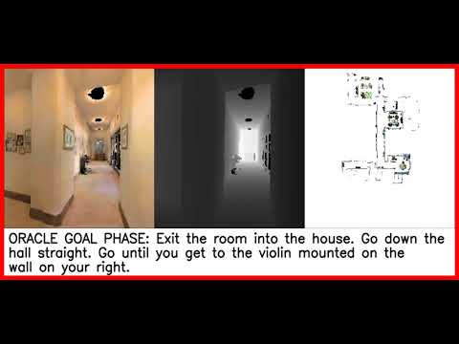
Deep Learning for Language and Robots: Navigation
https://jacobkrantz.github.io/ivln

Slide 46


Deep Learning for Language and Robots: Pick-and-Place
https://say-can.github.io/

Slide 47

Deep Learning for Language and Robots: Pick-and-Place
https://cliport.github.io/

Slide 48


Deep Learning for Language and Robots: Pick-and-Place
Robots Enact Malignant Stereotypes

Slide 49

Deep Learning for Language and Robots: Pick-and-Place
If you’re thinking, “sure, but that’s an ill-posed command”...
True! Correct behavior is probably to do nothing.
In what context might such commands arise from people who don’t know a single thing about machine learned biases?
https://www.dailynews.com/2022/11/08/lapd-could-soon-add-boston-dynamics-300k-robot-dog-to-its-arsenal/

Slide 50



Deep Learning for Medicine: Protein Folding
https://alphafold.ebi.ac.uk/

Slide 51

Deep Learning for Medicine: Compound Discovery
https://www.theverge.com/2022/3/17/22983197/ai-new-possible-chemical-weapons-generative-models-vx

Slide 52


Where Can You See Deep Learning Today?

Slide 53
A (Short) History of AI
…
1990—2012: Statistical approaches + subfield expertise; hand-engineered feature extraction
Resurgence of probability, focus on uncertainty
General increase in technical depth
Agents and learning systems… “AI Spring”?
2012—2019: Excitement: representation learning
Big data, big compute, neural networks
Some re-unification of subfields
AI used in many industries
2019—...: Overhype and reckless deployment
Massive compute; uncurated, Internet-scraped data at incredible scale
Black-box models behind API paywalls; closed source development
“Move fast and hurt people” philosophy seen across AI-enabled areas

Slide 54

Overhype
2019—...: Overhype and reckless deployment
What’s a concrete indicator of overhype?
Tech Layoffs Are Happening Faster Than at Any Time During the Pandemic

Slide 55
Back Up: What’s Artificial Intelligence?
What does intelligence mean in the context of a software or hardware system?
There’s really not a good answer to this! “AI” is a misleading name but it’s the one that stuck.
“the theory and development of computer systems able to perform tasks that normally require human intelligence, such as visual perception, speech recognition, decision-making, and translation between languages.”

Slide 56
How Do We Approach AI-related Applications?
That’s our history of AI!
Historically, rule-based systems that automated the combination of human-entered data and logical inference rules
With a surge of interest in statistics and uncertainty, predicting what might be true of data given what we’ve seen so far
Machine Learning methods
Machine learning in NLP, vision, and robotics remained partially symbolic, combinations of logical rules and hand-extracted features over which to learn functions (e.g., linear classifiers)

Slide 57
How Does Deep Learning Fit into AI?
Deep learning is a subset of methods for function approximation, with parameters adjusted via standard methods of machine learning like gradient descent
Is “deep learning” a subset of “AI”?
A computer system is a form of AI based on the applications it performs, not by its methods
Many AI applications utilize deep learning, as we have seen
So Deep Learning is a subset of Machine Learning
Machine Learning is a method for building AI systems

Slide 58
How Does Deep Learning Fit into AI?
Deep learning stands out from “classical” machine learning
End-to-end learning
The function we are approximating to map inputs X to outputs Y includes the features with which we represent X and Y
In classical ML, feature extraction was, to one degree or another, hand-engineered:
Color bins for images; bag-of-words vectors for words; …
With end-to-end learning, combining information from multiple input sources (images, text, robots, …) is more straightforward

Slide 59
Overview of Today’s Plan
Some light administrative notes
A flavor of Deep Learning and its Applications
Class survey
Course organization, assignments, and what to expect

Slide 60
Class Survey - Quiz 0
This survey will help us gauge the experience and technical proficiency of the student body at the beginning of the semester to better assess student needs and tweak the course organization as needed.
Also gives us a chance to use Google Forms in the format we’ll later use for our pop-up quizzes during some lectures
More on that when we go through course expectations

Slide 61
Class Survey - Quiz 0
The survey can be accessed via Piazza
Piazza → Resources → Pop-up Quizzes → Quiz 0
Or directly via this link
https://forms.gle/M2AV1BwZyq84HNcq5

Slide 62
Degree Level - What degree are you currently pursuing?
Undergraduate
Masters
PhD

Slide 63
Current department with which you’re affiliated
Computer Science
Electrical Engineering
Mechanical Engineering
Engineering (Other)
Arts & Sciences (Other)
Medical (Other)
Business (Other)

Slide 64
Python Programming Background
Fluent
Intermediate
Beginner
None
[open] List the other programming languages in which you are fluent or intermediate, if any

Slide 65
PyTorch Programming Background
Fluent
Intermediate
Beginner
None
[open] List other deep learning frameworks in which you are fluent or intermediate, if any

Slide 66
Experience Programming with Respect to Deep Learning
Know multiple state-of-the-art topics (e.g., Transformers, CNNs, RNNs, A3C, Diffusion)
Have worked with one or two topics in this space
Have heard some of these terms before but no working experience yet
None

Slide 67
Machine Learning Background
Have done research involving machine learning (applied or theoretical)
Have taken courses related to machine learning
None yet
[Open response] Briefly describe any Machine Learning and other relevant coursework/preparation you've undertaken

Slide 68
AI Research Background
Have been involved in multiple AI-related research projects
Have worked on at least one AI-related research project in the past (or currently)
Have some research experience in CS, but not AI specifically
Have some research experience outside CS
No research experience yet

Slide 69
Overview of Today’s Plan
Some light administrative notes
A flavor of Deep Learning and its Applications
Class survey
Course organization, assignments, and what to expect

Slide 70
Course Deliverables
Deliverable | Points of the total grade
Pop-up Quizzes | 5
Assignment #1 | 10
Assignment #2 | 10
Paper presentation | 10
Midterm | 20
Course Project | 45
TOTAL | 100
Project Deliverable | Points of the project grade
Project Proposal & Teaming | 2
Project Pitch | 1
Project survey | 5
2 meetings with TA | 2
Project Mid-report | 12
Final Presentation | 8
Final Report | 15
TOTAL | 45

Slide 71
Pop-up Quizzes (5pts)
In-class quizzes administered via Google Forms
Links will be posted to Piazza in the Resources section
These must be completed during class; you can think of these quizzes partially as participation credit
Each quiz will be worth roughly 5/N points, where N is the number of quizzes
How many quizzes will there be?
At least 5, counting today’s Quiz 0.
Maybe more!

Slide 72
Assignment #1 and #2 (10pts each)
These will be programming assignments
We will create and share a github repository you can clone/fork to work through these
Your submission will be executable code
We will provide some unit test scripts to make sure parts of your code are working properly before your submission

Slide 73
Paper Presentation (10pts)
Project teams of 4 people will be formed (more on that soon)
Each project team will give two 10-min slide presentations, each covering one research paper that is most related/significant to the project.
Each individual presentation should be given by 2 students from the project team with time split equally between presenters.
Grades on a per-presentation, not per-project team, basis.

Slide 74
Midterm Exam (20pts)
In-class exam
We will distribute a PDF with questions; answers will be submitted via a Google Form
Exam will be “open book” because how could it not be in 2023
However, if you have to search around lecture materials and online for every answer, you’ll run out of time

Slide 75
Course Project (45pts)
Form 4-person teams
Come up with a project idea related to deep learning for AI applications that either:
(1) introduces new technical contribution or insight to improve deep learning techniques for existing AI applications (e.g., computer vision, NLP, robotics)
(2) tackles a new and interesting problem setting using deep learning that is motivated by the unique problems posed by the application domain;
(3) proposes a new task formulation in the scope of deep learning and creates resources for studying the new task; or
(4) conducts a systematic analysis on issues (performance, bias, fairness, etc.) of existing deep learning models for a task.
Students can also select from a provided list of project topics but can also come up with their own.

Slide 76
Course Project (45pts)
Lion’s share of course points
Project deadlines roll through the semester and will be your main guideposts
Project teaming starts basically now; look for people with common interests and complementary skills!
Project Deliverable | Points of the project grade
Project Proposal & Teaming | 2
Project Pitch | 1
Project survey | 5
2 meetings with TA | 2
Project Mid-report | 12
Final Presentation | 8
Final Report | 15
TOTAL | 45

Slide 77
Course Project - Project Proposal & Teaming (2pts)
Project teaming starts basically now; look for people with common interests and complementary skills!
Inform the TAs via filling up the online form (one submission for each team); this form will be posted to Piazza.
For project grades, generally whole team receives the same grade for each of these entries.
Proposal: 5-6 slides on problem (scope & definition) + "today" (status of literature) + challenges + directions to innovate.
We will share a link to collect the slides.

Slide 78
Course Project - Project Pitch (1pt)
Each project team will spend 4 mins going through 2-3 slides to introduce their project proposal, focusing on the problem statement, main challenges to address, and directions to tackle the problem.
We will give you feedback on your proposal slides that you should incorporate into your pitch deck

Slide 79
Course Project - Project Survey Report (5pts)
A literature survey (e.g., "Related Work" section in a conference paper) of the relevant studies for your proposed problem/topic.
(1) what has been done related to your proposal (an organized view);
(2) what are the limitations or challenges remaining to be solved.
A 1.5-2 page (double-column) literature review write-up.

Slide 80
Course Project - 2 meetings with TA (2pts)
Each project will be assigned a guiding TA
Each team should meet with their Guide TA at least two times throughout the semester (e.g., during office hours) to solicit feedback on project direction, ask technical questions, etc.
Each such meeting contributes up to 1pt to the project grade
These meetings should be structured; come ready with both a presentation of what you’ve done so far and what you could use the TA’s advise for

Slide 81
Course Project - Midterm Report (12pts)
Details about the set of initial experiments you have done for the project.
Likely, these will involve reproducing the results of a state-of-the-art baseline model for the task of interest with code that you have implemented, or a pilot version of your proposed approach.
Talk about the specific dataset(s) you choose to use, the evaluation protocol and metric you decide to have, and the experiment settings.
Perform an analysis of what remaining errors this model makes and describe how you plan to create a new model for the final project that will address these errors (i.e., improve over this version).
A 3-page (double-column, excluding references) report

Slide 82
Course Project - Final Presentation (8pts)
A 7-min slide-based project presentation to briefly overview your proposed approach, the results obtained so far, and analysis as well as interesting findings.
We will share a google slide deck to collect the slides.
All four team members should be involved in the oral presentation of the slides

Slide 83
Course Project - Final Report & Project Code (15pts)
Present your novel contribution, experiments, discussion of results, and what next steps you would pursue in the future.
Format and coverage will be similar to the midterm report, but with experiments and discussion now complete based on further work since then.
An 8-page (double-column, excluding references) report.
A source codebase (github repo) with a README that explains your file structure and sample commands to reproduce experimental results

Slide 84
Course Deliverables
Deliverable | Points of the total grade
Pop-up Quizzes | 5
Assignment #1 | 10
Assignment #2 | 10
Paper presentation | 10
Midterm | 20
Course Project | 45
TOTAL | 100
Project Deliverable | Points of the project grade
Project Proposal & Teaming | 2
Project Pitch | 1
Project survey | 5
2 meetings with TA | 2
Project Mid-report | 12
Final Presentation | 8
Final Report | 15
TOTAL | 45

Slide 85
Due Dates and Late Day Tokens
Material is always due at 11:59pm PT on the day of the deadline; the late penalty is 5% off the total score per day after
Each student will have 5 Late Day Tokens to expend as they see fit on any non-presentation-based assignments
When you turn something in late, you must leave a note with the assignment specifying how many Late Day Tokens you wish to expend
Tokens are individual, so when using for project-related assignments they must be expended by all team members; team members who do not expend will receive the late penalty

Slide 86
Course Readings
In most weeks there are suggested readings that will help you deep dive into lecture topics.
Textbooks:
Deep Learning (MIT Press)
Ian Goodfellow, Yoshua Bengio, and Aaron Courville
Free online version is available at http://www.deeplearningbook.org/
Neural Network Methods for Natural Language Processing
Yoav Goldberg

Slide 87

[Jan 13] A Look at January
Week 1 | Jan 13
Week 2 | Jan 20
No Class! | Jan 27

Slide 88

[Jan 13] A Look at February Deliverables
Project Teams Formed | Feb 3
Assignment 1 Out | Feb 10
Project Proposal Due | Feb 17
Assignment 1 Due | Feb 24
Midterm Exam | Feb 24
Three weeks to form your project teams; take that step seriously!

Slide 89
Course Office Hours
TA Office Hours
HW questions; project questions & feedback
For Week 2, TA office hours will be:
Wednesday Jan 18
3pm-4pm
https://usc.zoom.us/my/salhotra
Final recurring office hours will be posted to the syllabus, website, and Piazza
Jesse Thomason
Deqing Fu
Gautam Salhotra
Instructor Office Hours
Mon 10am-11am
SAL 244
NOT for homework related questions.
Tejas Srinivasan
Bingjie Tang

Slide 90
CSCI 566: Deep Learning and its Applications
Jesse Thomason
Course Introduction

